Slide 1
Smart Camera for Enforcing Social Distancing
Aayush Gupta | Daksh Thapar
M-20-130

Slide 2
COVID-19

Slide 3
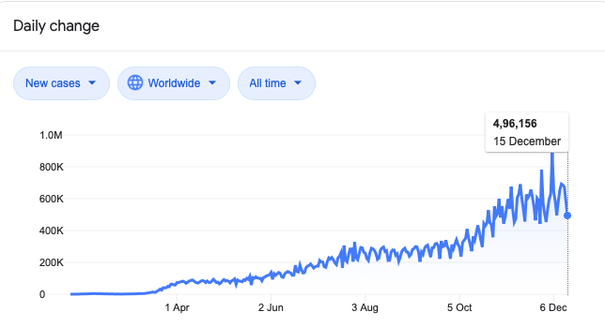
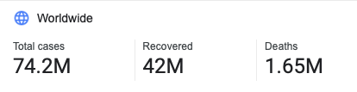
Figure 1: COVID-19 figures worldwide, from Wikipedia

Slide 4
Social Distancing

Slide 5
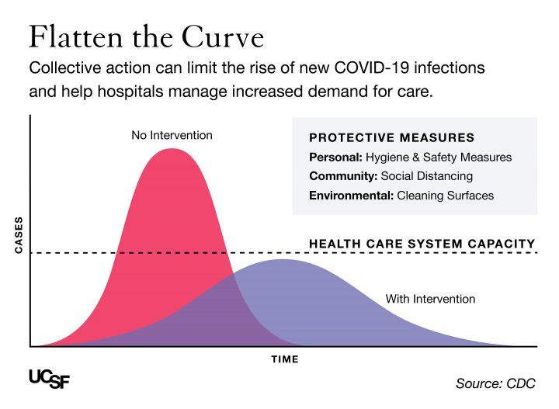
Figure 2: Effect of social distancing and other measures on curve of COVID-19 cases by CDC

Slide 6
Motivation for Project

Slide 7
State of the Art

Slide 8
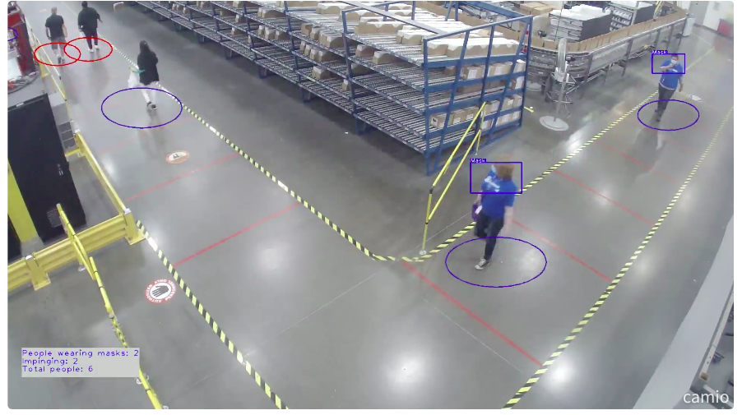
Camio - Social Distancing & Mask Detection
AI
ML
Virtual 3D floor-plan grid- movement
Personalized Alerts
Figure 3: Social Distancing & Mask Detection using Camio

Slide 9
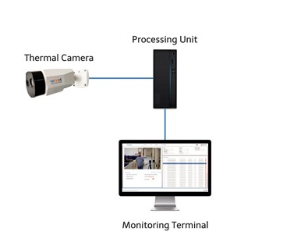
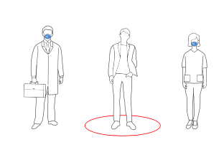
FebriEye, Vehant Technologies
AI based Thermal Temperature Monitoring System
Non-Contact Detection
Thermal Camera
Real time alerts
Figure 4: Social Distancing by FebriEye

Slide 10
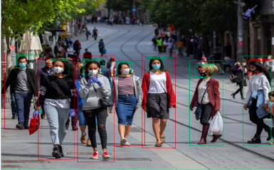
Deep Learning based Safe Social Distancing and Face Mask Detection in Public Areas for COVID-19 Safety Guidelines Adherence (Shashi Yadav, July 2020)
Computer Vision based approach
Real-Time automated monitoring
Implementing model on RaspberryPi4
Three aspects: detection, tracking, and validation
Figure 5: Safe Social Distancing and Face Mask Detection in Public Areas

Slide 11
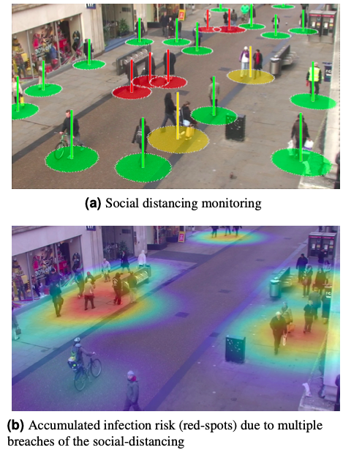
DeepSOCIAL: Social Distancing Monitoring and Infection Risk Assessment in COVID-19 Pandemic
Deep Neural Network-Based model
Automated people detection, tracking
Euclidean pairwise distances
YOLOv4-based framework
Figure 6: Red spots due to multiple breaches

Slide 12
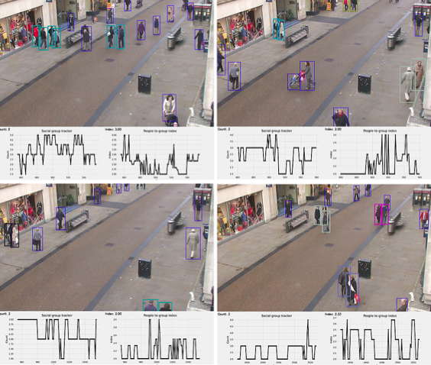
Monitoring COVID-19 social distancing with person detection and tracking via fine-tuned YOLOv3 and Deepsort techniques (Narinder Singh Punn, Sanjay Kumar Sonbhadra and Sonali Agarwal)
Deep learning based framework
YOLO v3 object detection model
Deepsort Algorithm with bounding boxes
Further compared with faster region-based CNN and SNN
Figure 7: Monitoring social distancing with person detection and tracking

Slide 13
Methodology

Slide 14
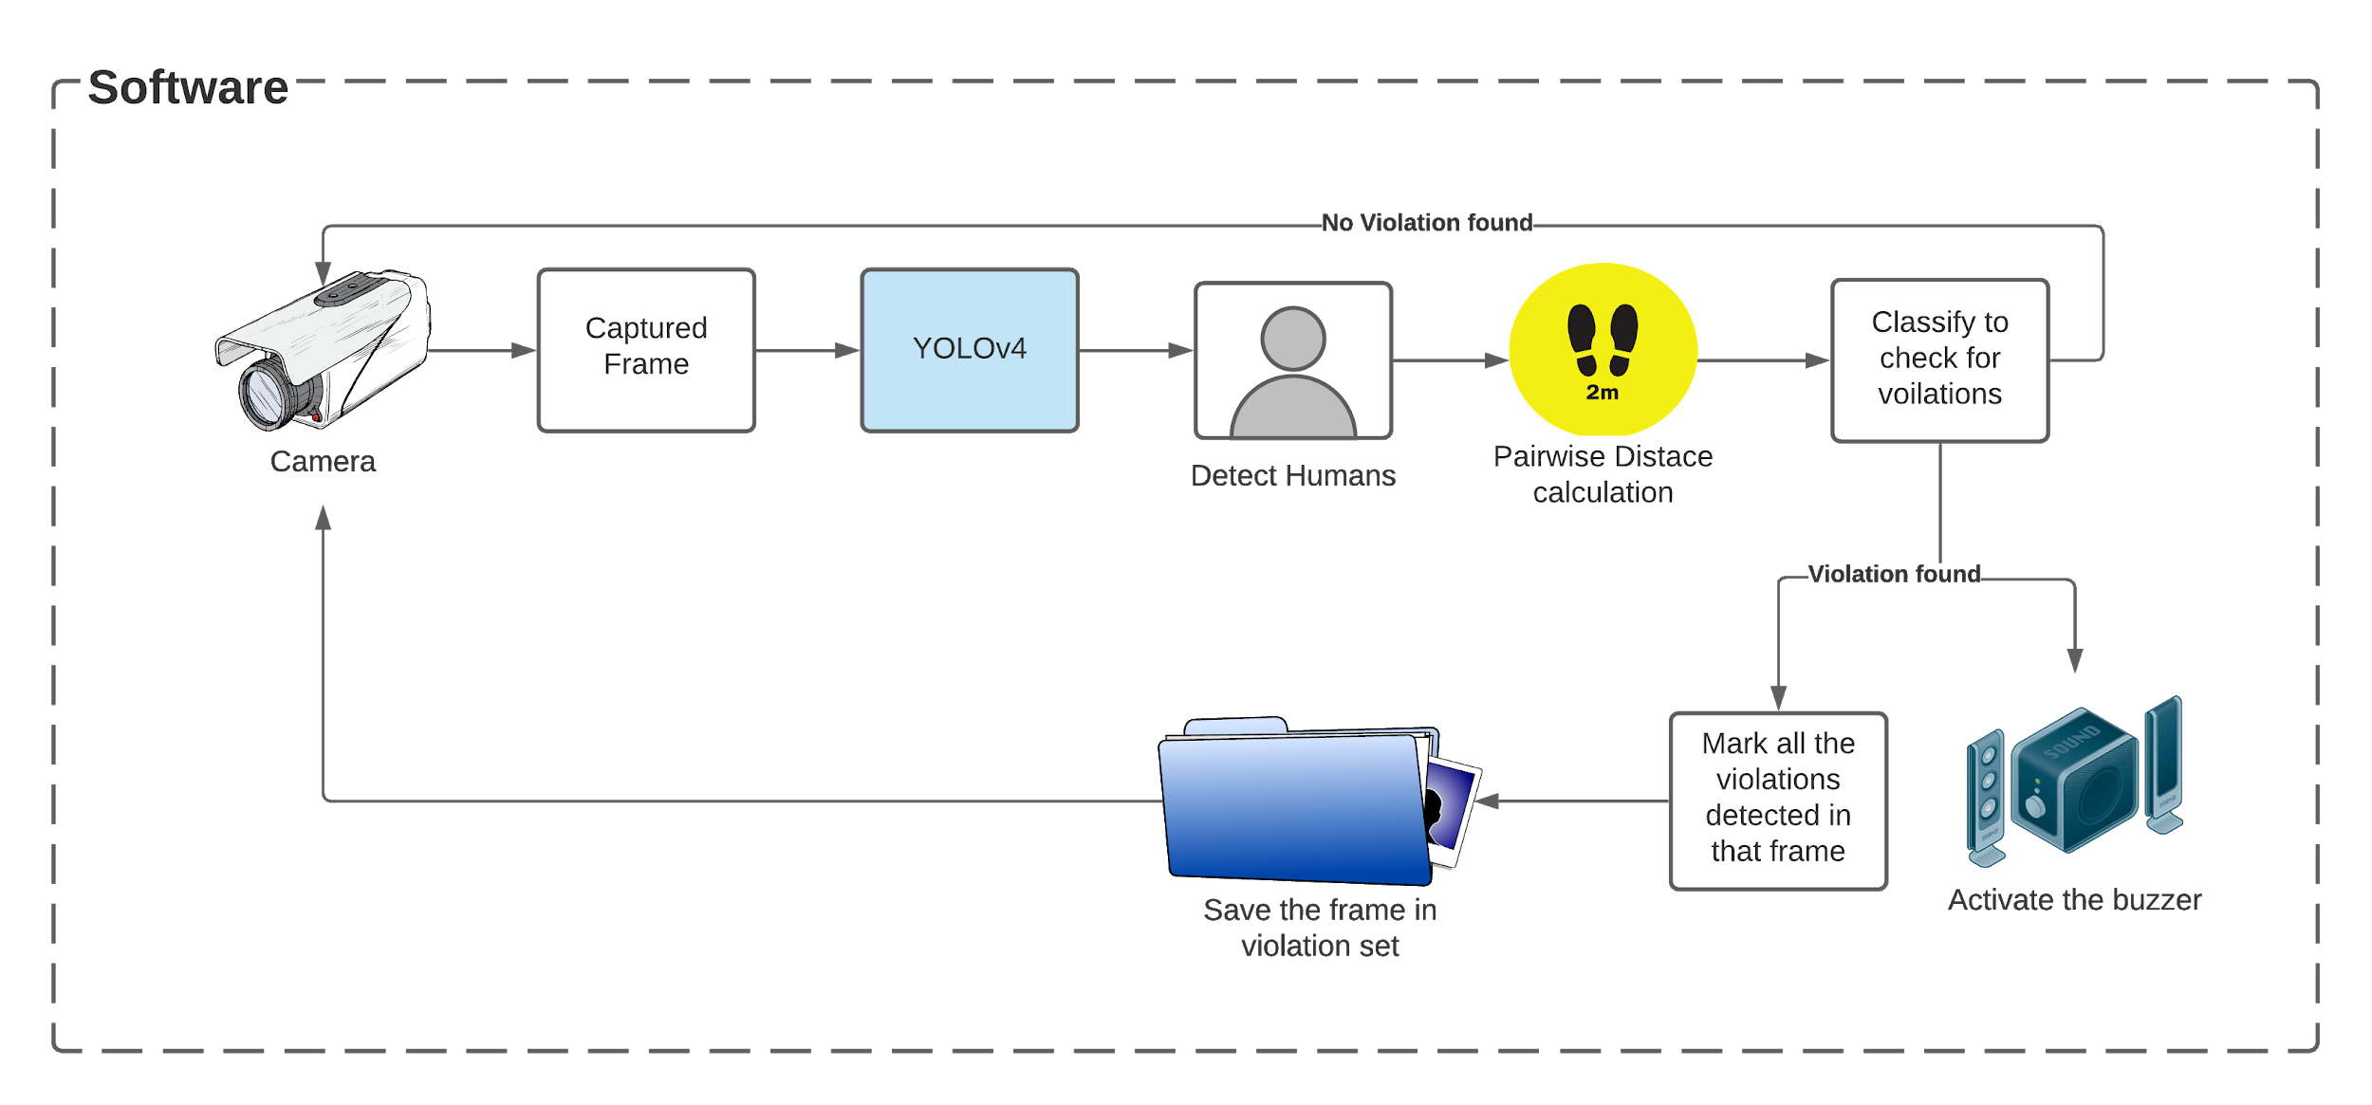
Flow Chart
Figure 8: Approach shown by diagram

Slide 15
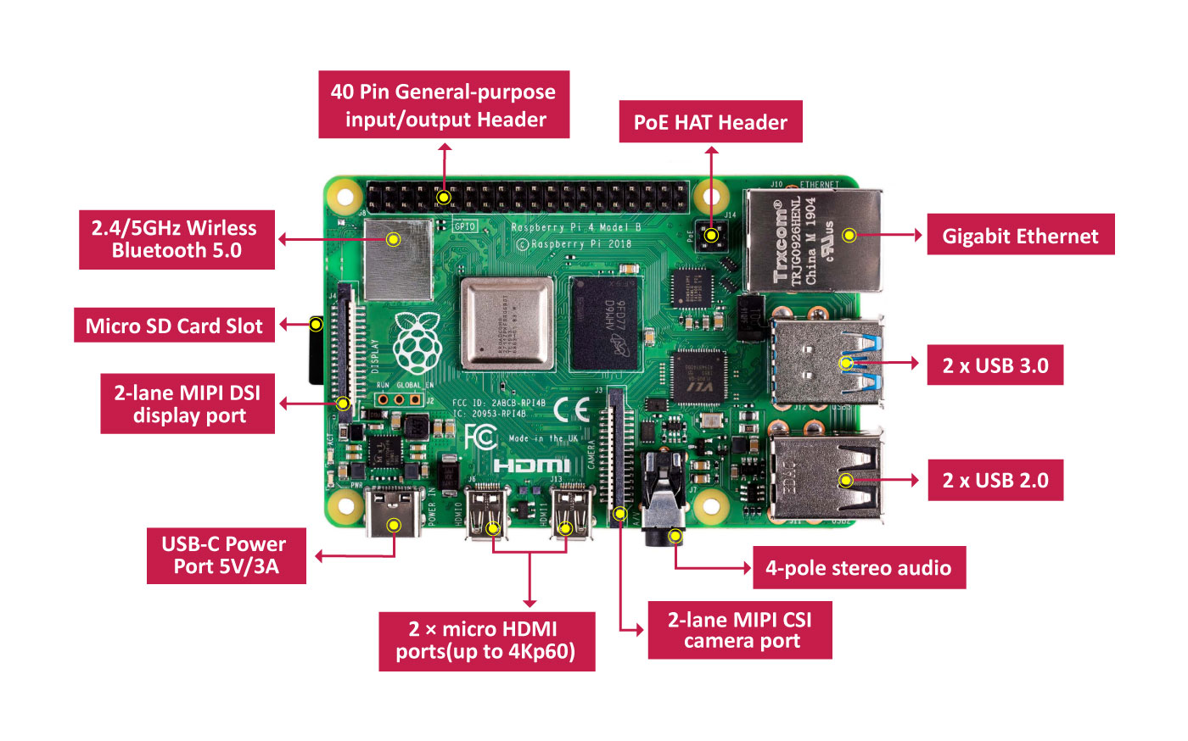
RaspberryPi4
Figure 9: RPi4 Architecture

Slide 16
Libraries for Object detection

Slide 17
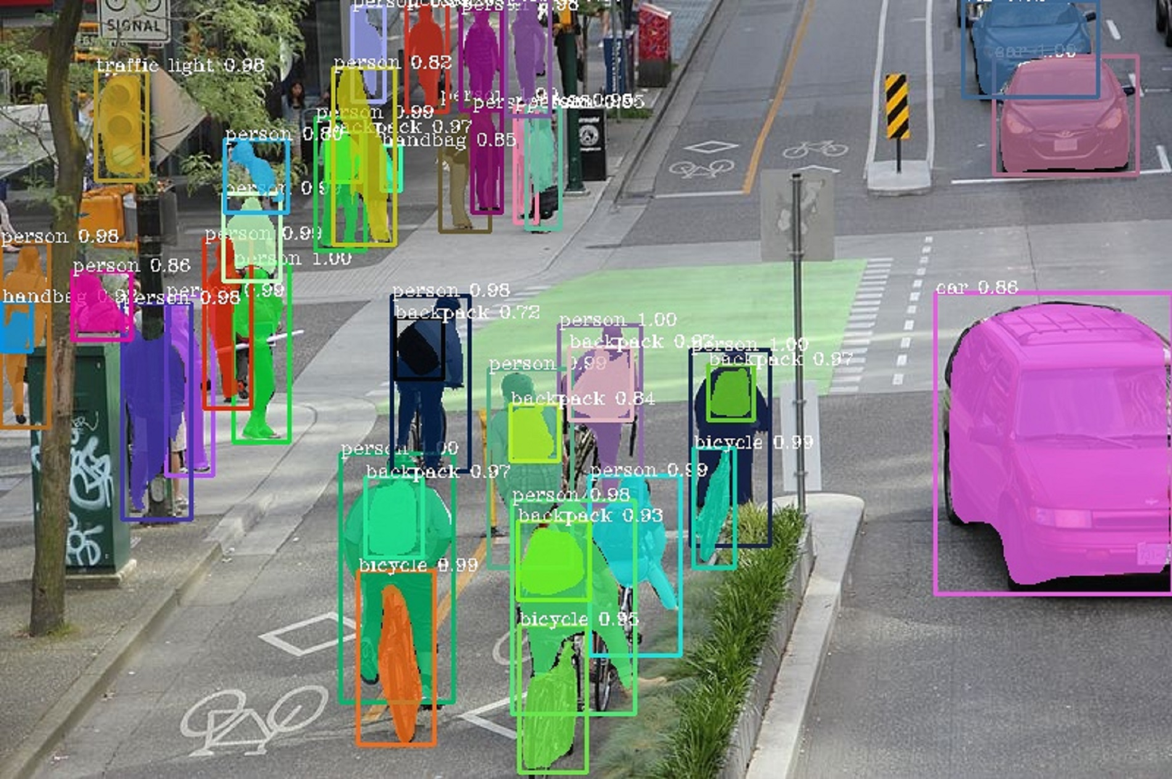
Custom built library inspired by Pixellib
Open-source Computer Vision Library (obtained from GitHub)
Performs instance segmentation of objects
Deep Learning Mask R-CNN models to obtain and distinguish between 80 types of objects present in the pre-
trained Coco dataset.
Figure 10: Monitoring social distancing with Pixellib

Slide 18
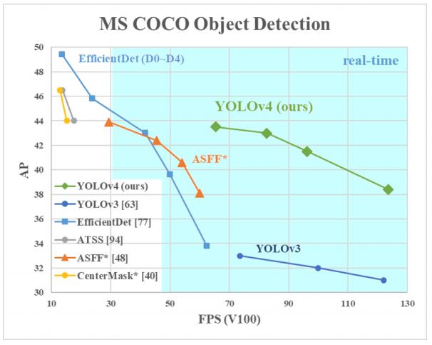
YOLO v3, v4
Figure 11: Average Precision comparisons for different architectures

Slide 19
Object Detection using YOLO

Slide 20
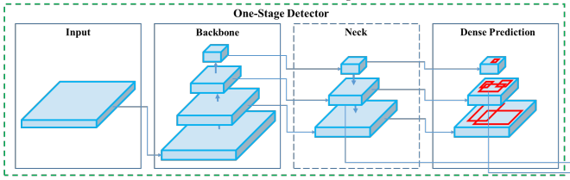
YOLO v3,v4 Architecture
Figure 12: One stage detector architecture

Slide 21
Pairwise Euclidean Distance Calculation
Distance Mapping

Slide 22
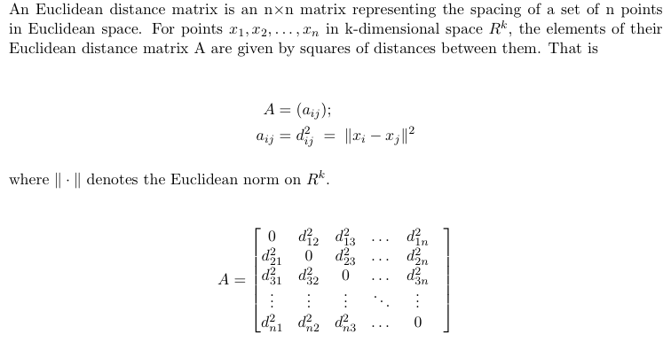
Euclidean Distance

Slide 23
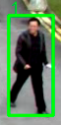
Mapping distance using bounding boxes
We know that the average human height is 5.5 ft(~165cm) and we mapped this distance to the height of every bounding box, which gives us a relation between the pixel distance throughout the frame and the real distance.
Let height of bounding box be h’ True height h=165cm i.e. h=165cm -> h’ => h=1cm -> h’/165 => h=182.8cm -> (h’/165)*182.8 , where 182.8cm= 6ft, our threshold for social distancing
Figure 13: Bounding box

Slide 24
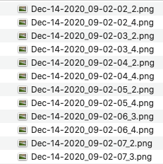
Database Management
Here is one instance of a file name containing frame of violation:
Figure 14: Suitable format for saving snapshot

Slide 25
Experiments

Slide 26
Custom built library inspired by Pixellib

Slide 27
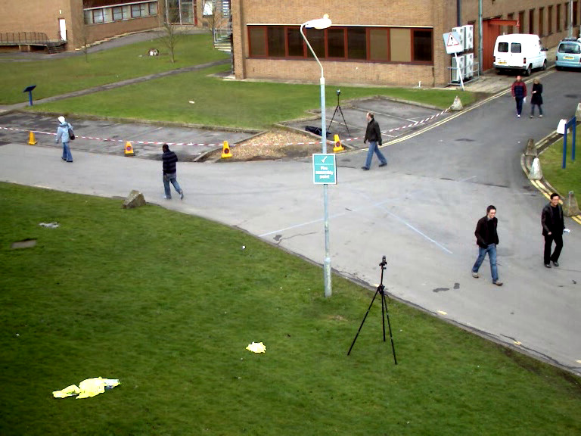
Figure 15: Original Image

Slide 28
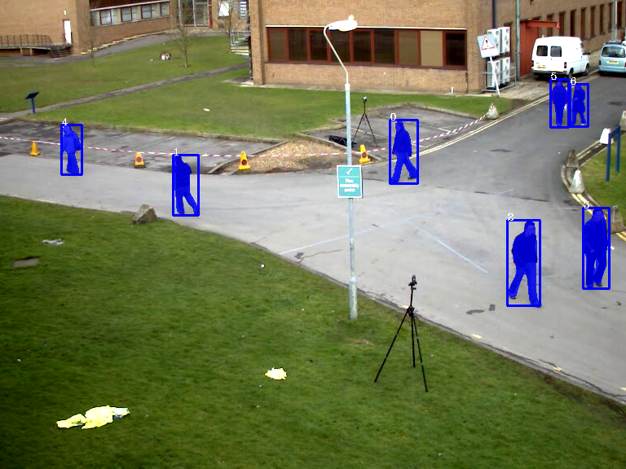
Figure 16: Final Image

Slide 29
YOLO based detection
(3 Scenarios)

Slide 30
Scenario 1 (outdoor, natural illumination)

Slide 31
Figure 17: Original Image

Slide 32
Mask- RCNN model, detecting humans

Slide 33
Bounding Boxes

Slide 34
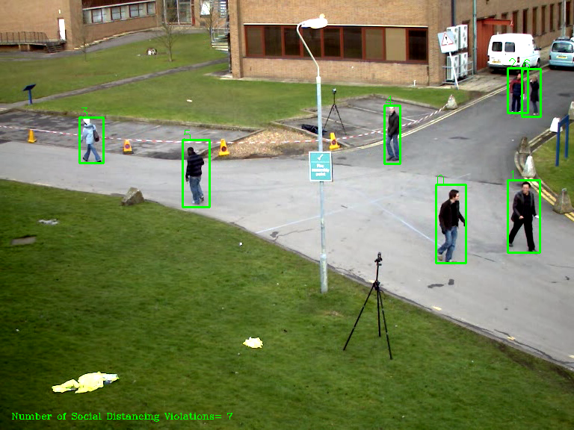
Figure 18: Detected humans and applied bounding boxes

Slide 35
Creating Distance Mapping

Slide 36
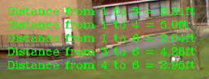
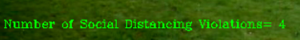
Pairwise Distance Calculation
Displayed at the top left of the frame during runtime, contains pairwise euclidean distances for all pairs that are violating social distancing, the persons are identified by unique “ids”
Figure 19: Pairwise distances
Displayed at the bottom left of the frame during runtime, depicts the total number of social distancing violations
Figure 20: Number of violations

Slide 37
Comparing Distances with 6ft

Slide 38
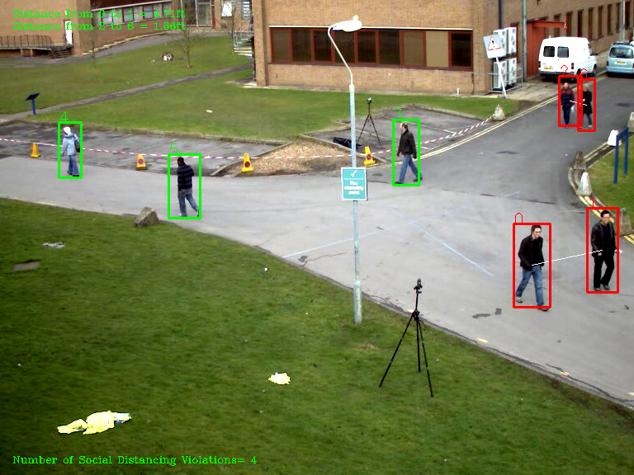
Figure 21: Final Image

Slide 39
Storing frames in Database, Buzzer

Slide 40
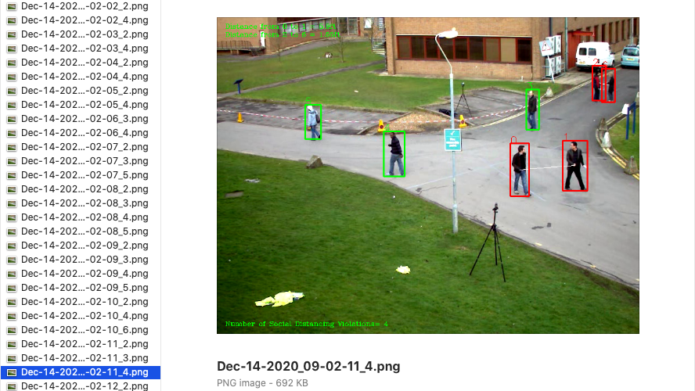
Figure 22: Snapshot saved in directory in desired format

Slide 41
Recap of steps with Scenario 1 (YOLOv4)
Figure 23: Images for scenario 1 using YOLOv4

Slide 42
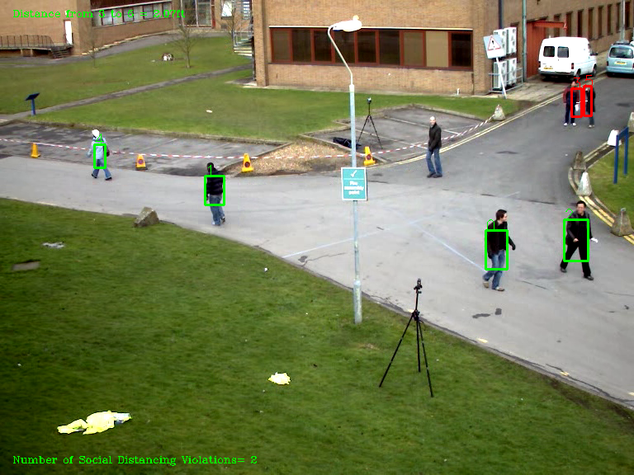
Recap of steps with Scenario 1 (YOLOv3)
Figure 24: Images for scenario 1 using YOLOv3

Slide 43
Scenario 2 (outdoor, natural illumination)

Slide 44
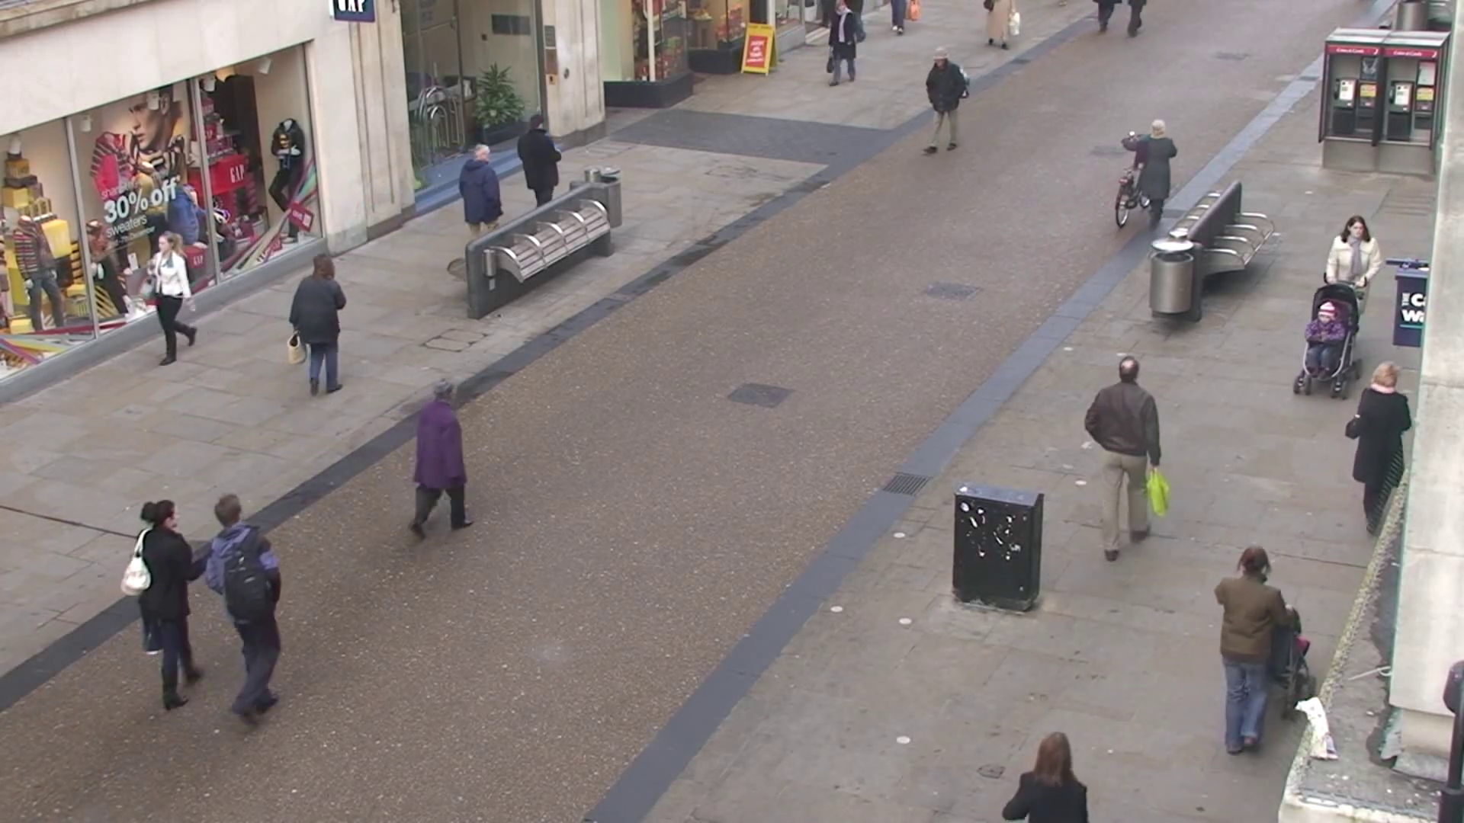
Figure 25: Original Image

Slide 45
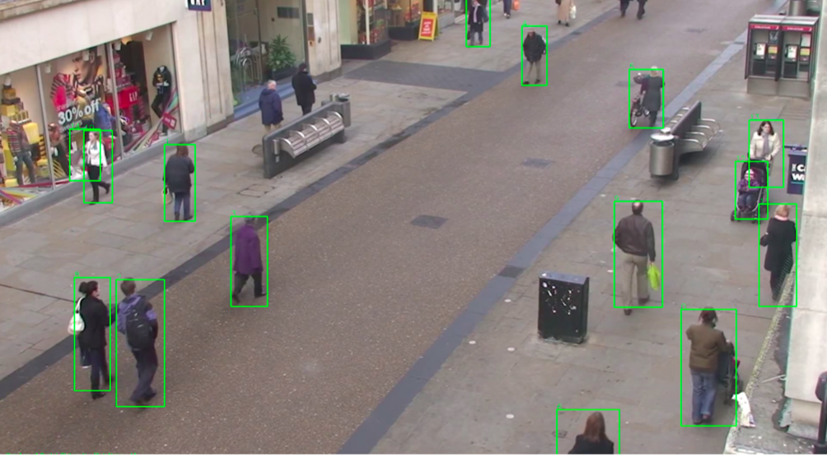
Figure 26: Human detection and bounding boxes

Slide 46
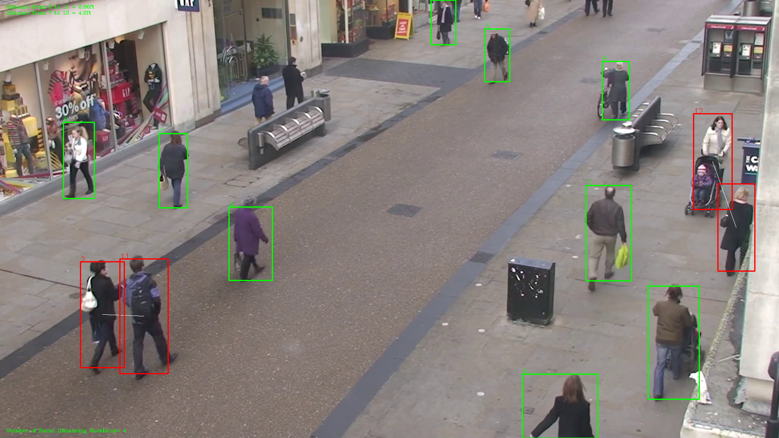
Figure 27: Final Image

Slide 47
Scenario 3 (indoor, artificial illumination)

Slide 48
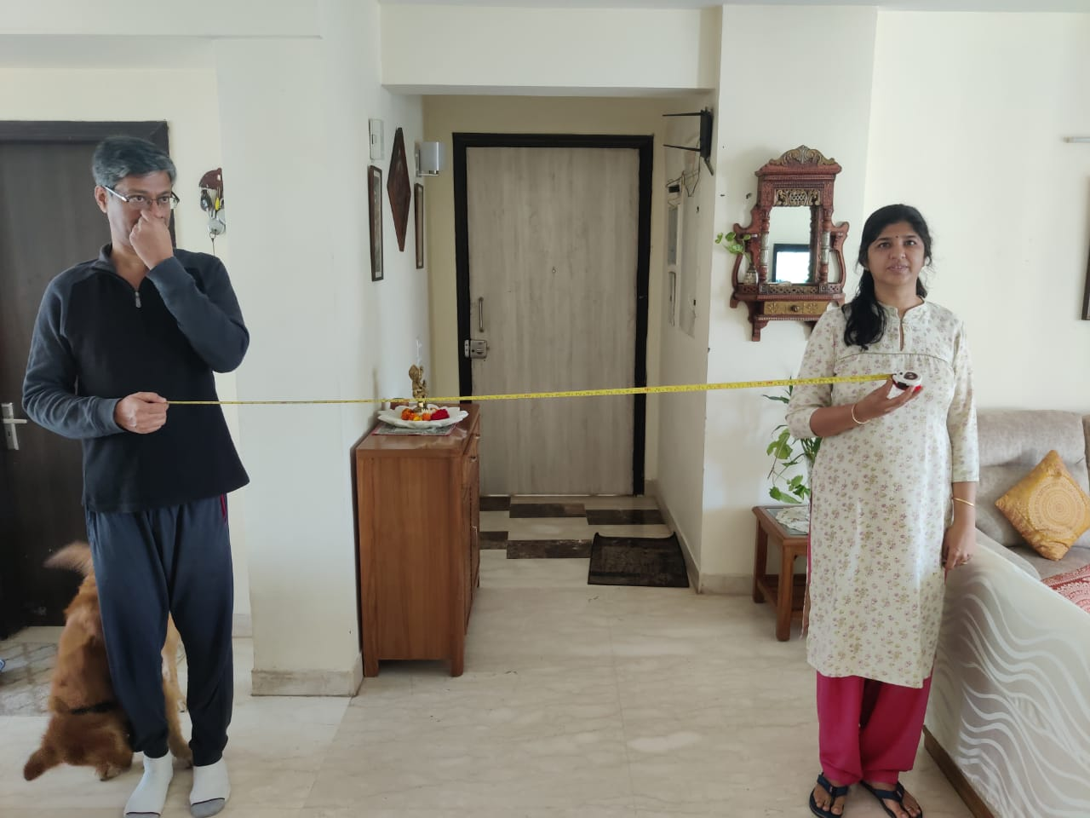
Figure 28: Original Image

Slide 49
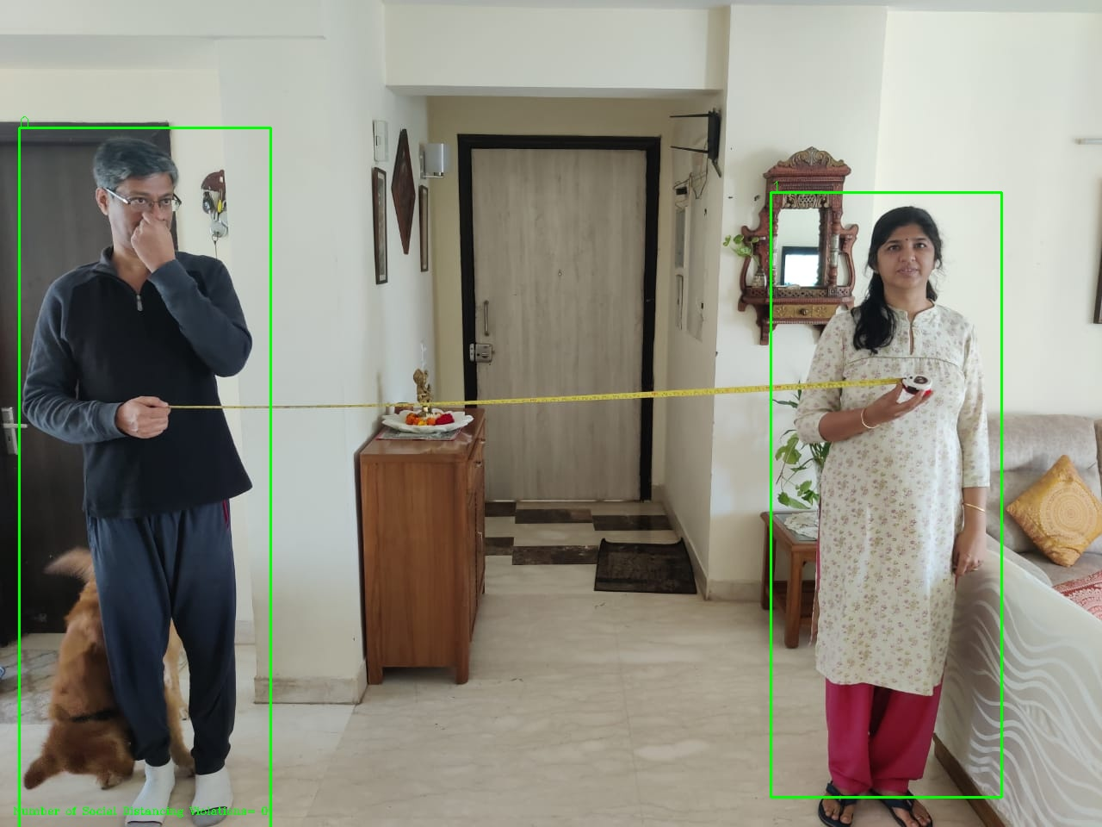
Figure 29: Human Detection and bounding boxes

Slide 50
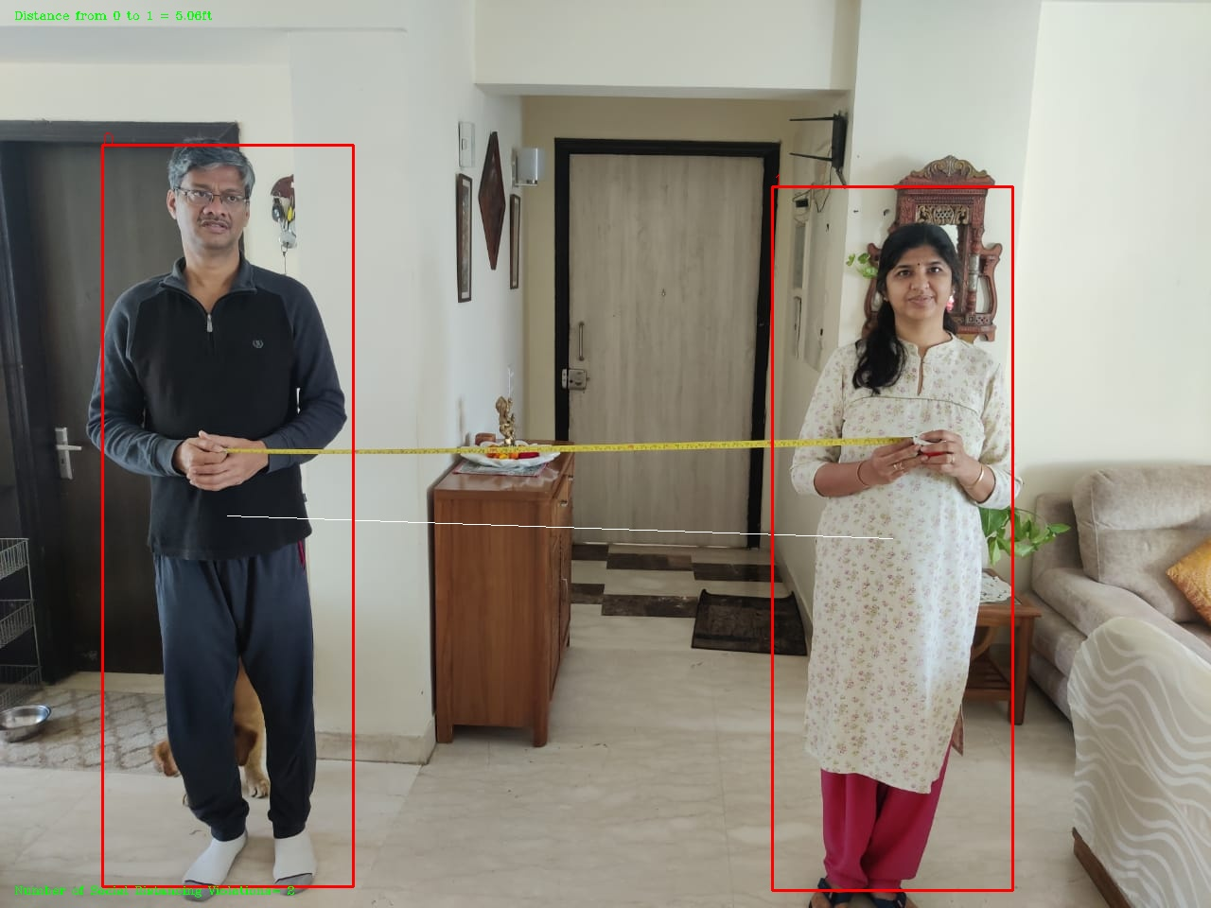
Figure 30: Final Image 1

Slide 51
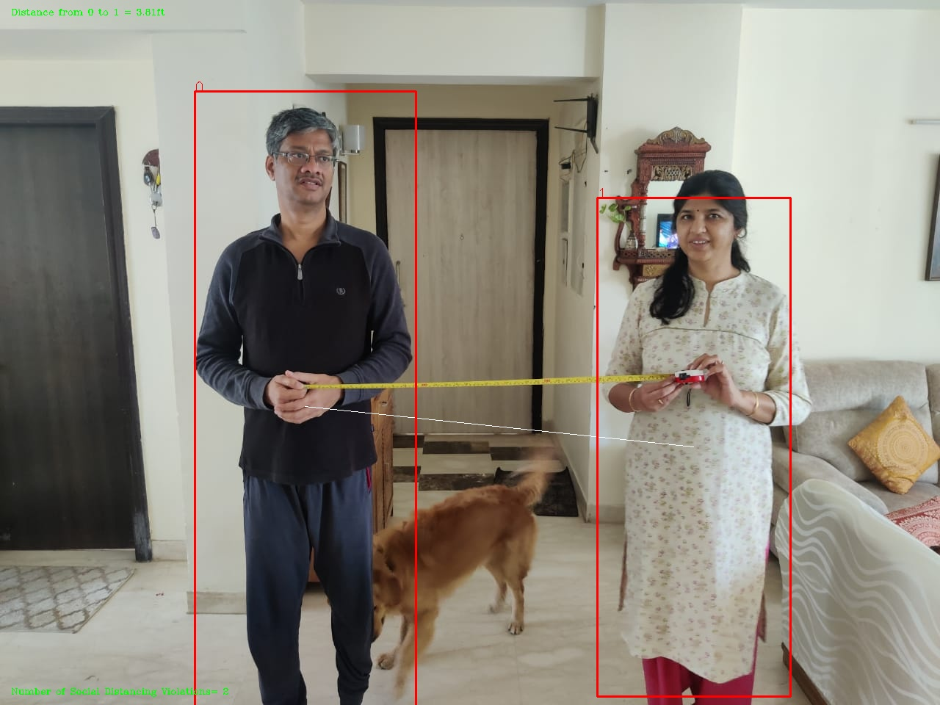
Figure 31: Final Image 2

Slide 52
Results

Slide 53
Custom built library inspired by Pixellib
Average time per frame = 15.0029s
Well structured bounding boxes
Clear inaccuracies in violation detection for social distancing
Figure 32: Final Image using Pixellib

Slide 54
Scenario 1: YOLOv3 vs YOLOv4

Slide 55
Scenario 1: YOLOv3
Average time per frame = 0.2476s
Number of social distancing violations reported = 2
Distance from person 3 to 5=2.07ft
2.07ft < 6ft => Violation of Social distancing
Figure 33: Final Image using YOLOv3

Slide 56
Scenario 1: YOLOv4
Average time per frame = 0.15527s
Number of social distancing violations reported = 4
Distance from person 0 to 1 = 4.71ft
Distance from person 2 to 6 = 1.86ft
4.71ft < 6ft => Violation of Social distancing
1.86ft < 6ft => Violation of Social distancing
Figure 34: Final Image using YOLOv4

Slide 57
Scenario 2: YOLOv4
Average time per frame = 0.21384s
Number of social distancing violations reported = 4
Distance from person 2 to 11 = 2.06ft
Distance from person 7 to 12 = 4.20ft
2.06ft < 6ft => Violation of Social distancing
4.20ft < 6ft => Violation of Social distancing
Figure 35: Final Image using YOLOv4

Slide 58
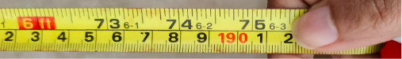
Scenario 3: YOLOv4
True distance between humans= 6.25ft
Figure 36: Original Image using YOLOv4

Slide 59
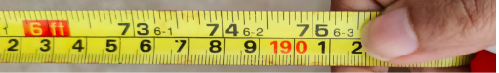
Scenario 3: YOLOv4
Number of violations=0
True distance between humans= 6.25ft
Estimated distance between humans= 6.31ft
6.31ft > 6ft => Not a violation of social distancing
Figure 37: Human detection and bounding boxes

Slide 60
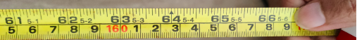
Scenario 3: YOLOv4
Number of violations=2
True distance between humans= 5.5ft
Estimated distance between humans= 5.55ft
5.55ft < 6ft => Violation of social distancing
Figure 38: Final image at 5.5ft

Slide 61
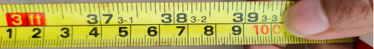
Scenario 3: YOLOv4
Number of violations=2
True distance between humans= 3.25ft
Estimated distance between humans= 3.52ft
3.52ft < 6ft => Violation of social distancing
Figure 39: Final image at 3.25ft

Slide 62

Demonstration Video 1

Slide 63
Demonstration Video 2

Slide 64
Demonstration Video 3

Slide 65
Demonstration Video 4

Slide 66
Demonstration Video 5

Slide 67
Demonstration Video 6

Slide 68
Challenges and Limitations

Slide 69
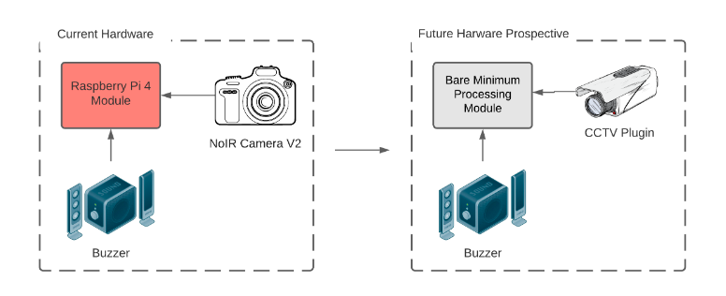
Figure 40: Future Hardware Prospective

Slide 70
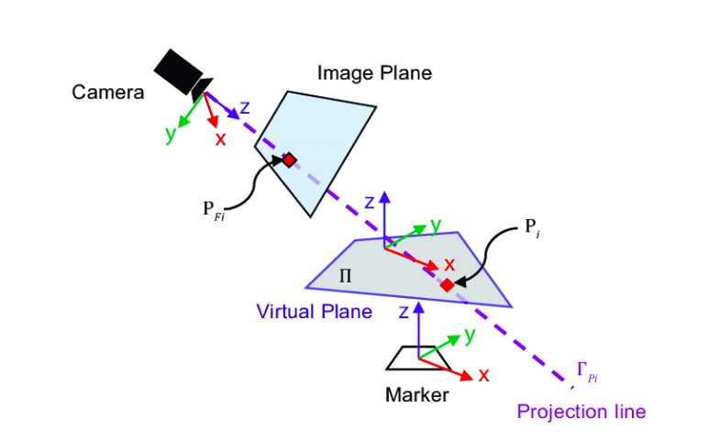
Figure 41: Transformation of a 3D point on the image plane to the 2D coordinates

Slide 71
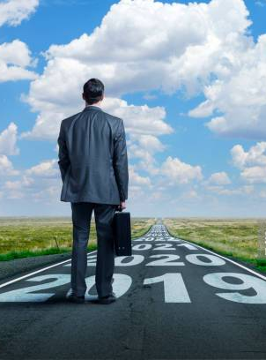
Future prospects

